Slide 1
Online Voting system Using Face Recognition
Advisor: Dr. Kashif Ishaq

Slide 2
THE TEAM
Muhammad Tazeem Sajid
F2019065042
Hamza Mudassir
S2020105012
Sohaib Naveed
F2019105092
Ghulam Mustafa
F2019065103
Team

Slide 3
CONTENT
Problem
Objective
Solution/Introduction
Scope Of Project
Tool Technologies
User Interface Screen

Slide 4
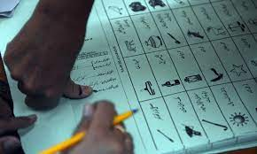
PROBLEM
Environmental Effect
Winner Takes the All
Cost
Time Consuming
Increase Manual Work
Post Election

Slide 5
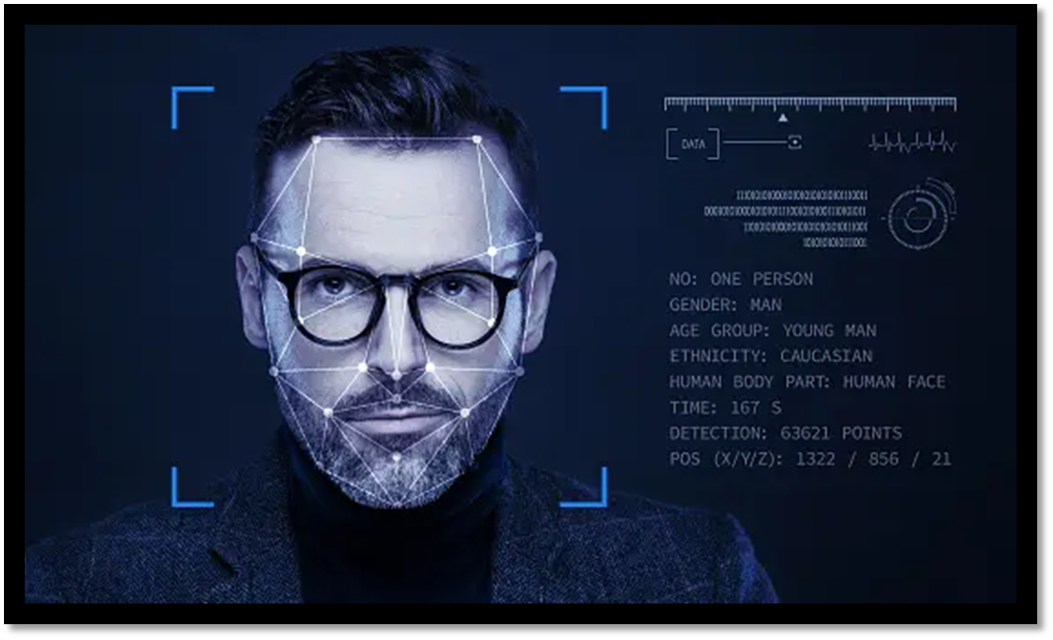
SOLUTION OF THE PROBLEM
FACIAL RECOGNITION TECHNOLOGY

Slide 6

Objective
.
Modernize the Voting Process
Ensure Accurate Vote Counting
Streamline Voting
Enhance Security
Increase Voter Participation
Practical Application

Slide 7





ARCHITECTURE
USER INTERFACE
VOTING MODEL
FACIAL RECOGNITION MODEL

Slide 8
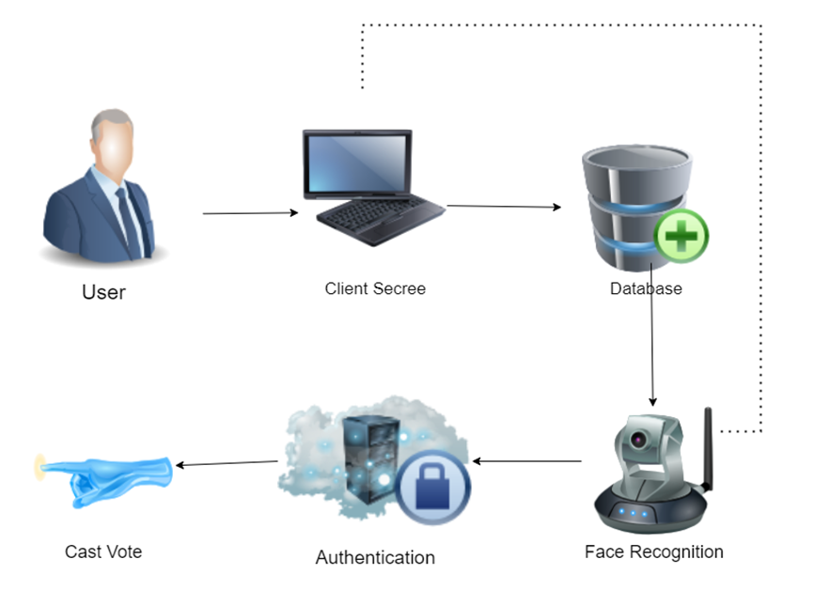
WORKING OF PROJECT
?

Slide 9


SCOPE OF PROJECT
Voting Interface
Face recognition Authentication
Vote submission and Counting
Limited User Base
Basic Security Measure
Prototype Development

Slide 10
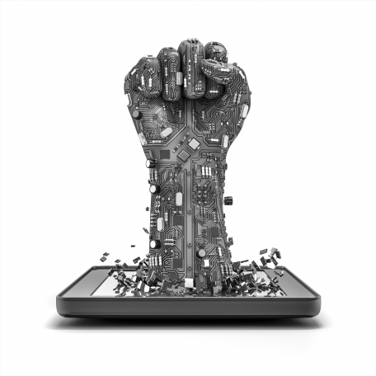

Beneficial's
Voters
Political Parties
Government
Technology Provider
Candidates
Election Official’s

Slide 11
TOOL TECHNOLOGIE’S
Programming Languages:
The system is developed using programming languages Html, Css, JScript, React, boot strap, Laravel, PHP.
2.Database Management System:
A secure database management system MySQL is used to store voter information and voting records.
3.Security Measures:
The system will require various security measures such as encryption, secure authentication like CNIC checking and firewalls to prevent hacking, tampering, or unauthorized access.
4.Hardware:
Mobile and computer with better data connection required
5.Software
Xampp, Visual studio, Composer, Node.js

Slide 12
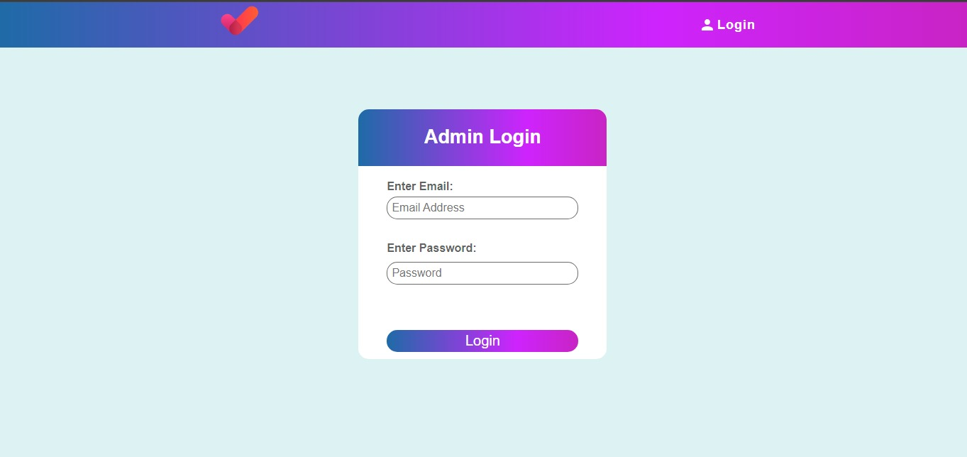
Interface Screen

Slide 13
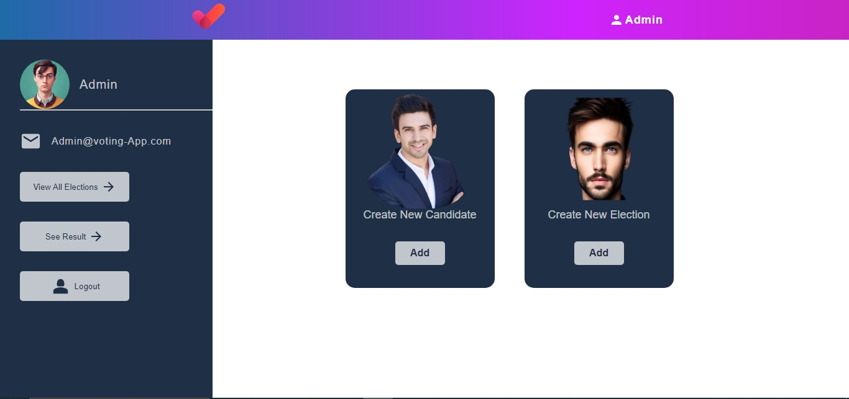

Slide 14
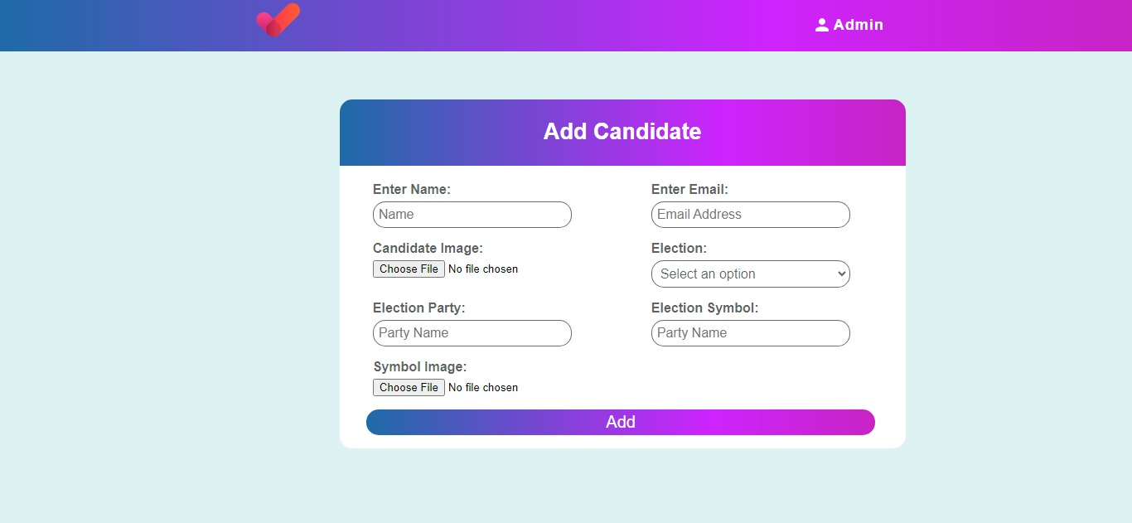

Slide 15
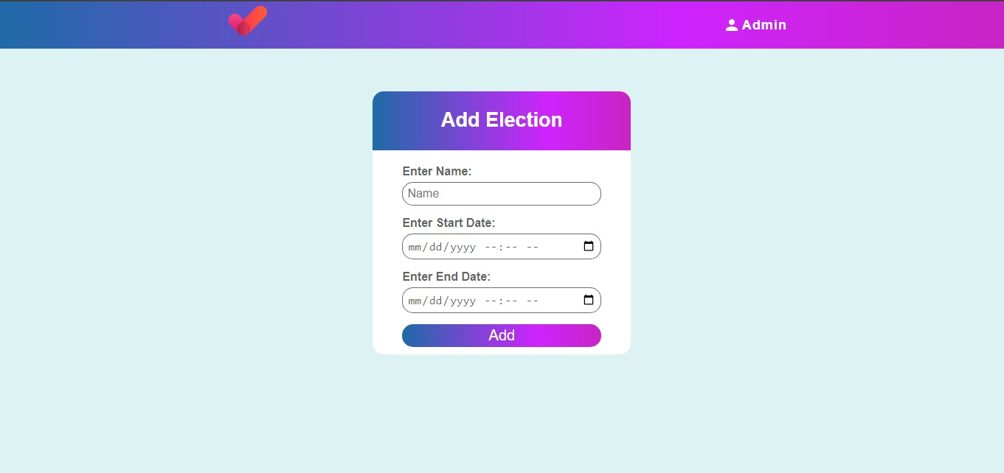

Slide 16
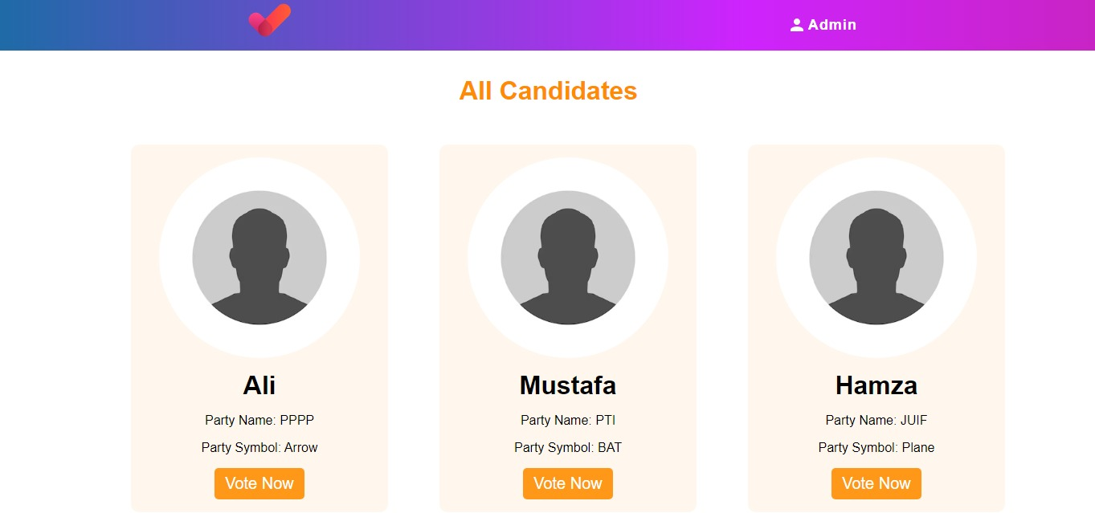

Slide 17
THANKS!
tazeemsajid22@gmail.com

